Slide 1
Presentation
Giorgos Papadourakis – TEI of Crete, Greece

Slide 2
Outline
Blended-AIM project
BlendEd course unit
Work plan

Slide 3
Project

Slide 4
Motivations
Project/Internship activities foster students’ employability
International exposure during studies impacts students development as professionals, individuals and citizens
Barriers to mobility
Cost of international mobility
Risk of missing local job opportunities
Anxiety while anticipating long periods abroad
Disabilities and chronic diseases permanently requiring specific treatment
Blended education/mobility overcomes all of these.

Slide 5
Blended-AIM project
Blended-AIM – Academic International Mobility
Erasmus+ strategic partnership
3 years, October 2015 to September 2018
10 partners
several study areas: Computer Engineering, Arts, Business, Marketing
several stakeholders: HEI, Associations, Companies.

Slide 6
Partnership
P01 – IPP, Instituto Politécnico do Porto, Portugal
P02 – USiegen, Universität Siegen, Germany
P03 – GCU, Glasgow Caledonian University, United Kingdom
P04 – EAEC, European Association of Erasmus Coordinators, Cyprus
P05 – GISIG, Geographical Information System International Group, Italy
P06 – UPB, Universität Paderborn, Germany
P07 – Odisee, Odisee Technologiecampus - Ghent, Belgium
P08 – FHJ, Fachhochschule Joanneum, Austria
P09 – LUCA, LUCA School of Arts, Belgium
P10 – TEICrete, Technological Education Institute of Crete, Greece

Slide 7
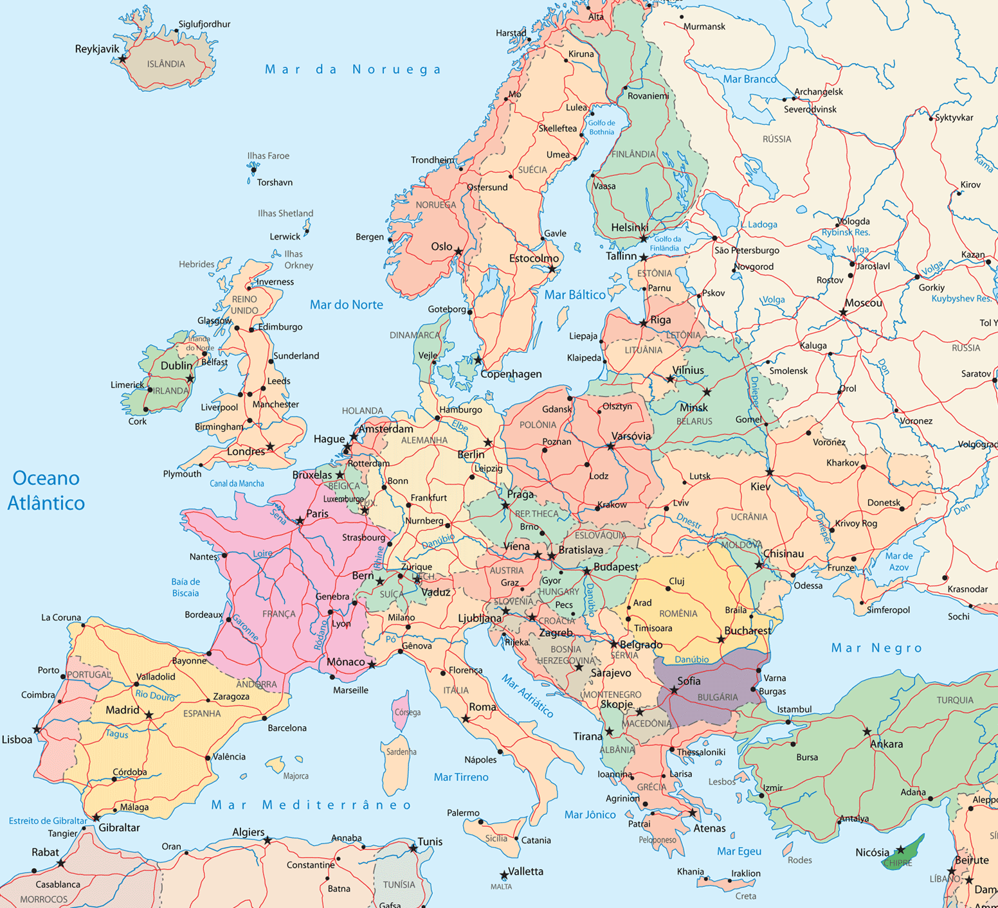
Partnership

Slide 8
Objectives
Goal
Sustainable promotion of students’ employability by means of blended mobility
Objectives
Structural:
Settle the European foundation for blended mobility, awareness raising
Foster internationalization of education
Deploy, test and disseminate a blended mobility capstone project course unit
Pedagogical:
Promote students’ employability through non-formal learning not requiring curricula changes
Promote international experience of undergraduate students
Boost the provision of professional skills, support collaborative learning and critical thinking.

Slide 9
BlendEd course

Slide 10
Target
Final year undergraduate students
Capstone project course unit

Slide 11
Certification
ECTS credits from local Project/Internship course unit

Slide 12
Workplan

Slide 13
BlenEd course unit
2015/16
Kick-off meeting: Paderborn, Germany, 22 to 26 February 2016
Final meeting: Glasgow, UK, 20 to 24 June 2016
Project: Project management toolbox
Company: UWS Business Solutions GmbH, Germany
Students: 15
2016/17
Kick-off meeting: Rovereto, Trento, Italy, 27 February to 3 March 2017
Final meeting: Graz, Austria, 19 to 23 June 2017 (TBC)
Project: Management of indoor assets in hospitals using beacons and mobile app
Company: Trilogis, Italy
Students: 16+3x2
2017/18
Kick-off meeting: Gent, Belgium, 19 to 23 February 2018 (TBC)
Final meeting: Heraklion, Greece, 18 to 22 June 2018 (TBC)
Project & company: TBD
Students: 16+3x2+5x2

Slide 14
Intellectual Outputs
O1 - Blended mobility kit for students (and teachers)
O2 - Employability, project work and blended mobility report
O3 - BlendEd guide (course specification, setup and implementation)
O4, O5, O6 - BlenEd pilot editions
O7 - European foundation for blended mobility
O8 - Annual forum on employability (drivers for employability, skills and competences, ...) and blended mobility (tools, methodologies, benefits, best practices, ...)

Slide 15
Multiplier Events
Focus groups for O2
Portugal, 30/09/2016 (E1)
Germany (E2)
United Kingdom (E3)
Cyprus (E4)
Italy (E5)
Belgium, 28/06/2016 (E6)
Austria, 02/03/2016 (E7)
Greece (E8)
Annual Forum
2016 – EAPRIL Conference, 22 to 25 November, Porto (E9)
2017 – ERACON Congress, May, Maribor, Slovenia TBC (E10)
2018 – ERACON Congress, May, TBD (E11)

